Slide 1
15-316: Software Foundations of Security and Privacy
Introduction
Fall 2023

Slide 2
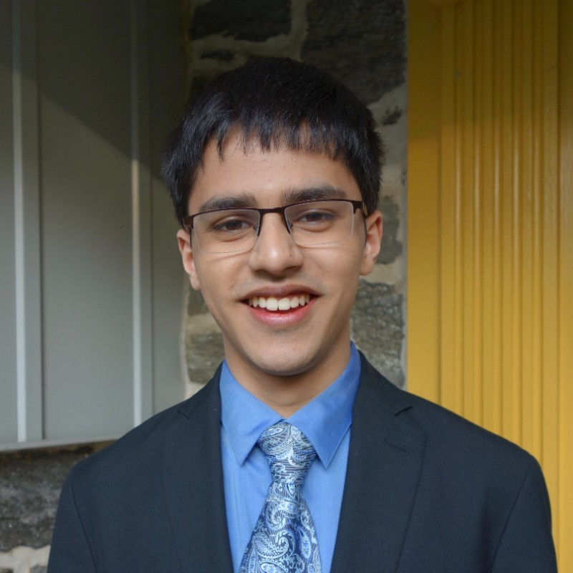
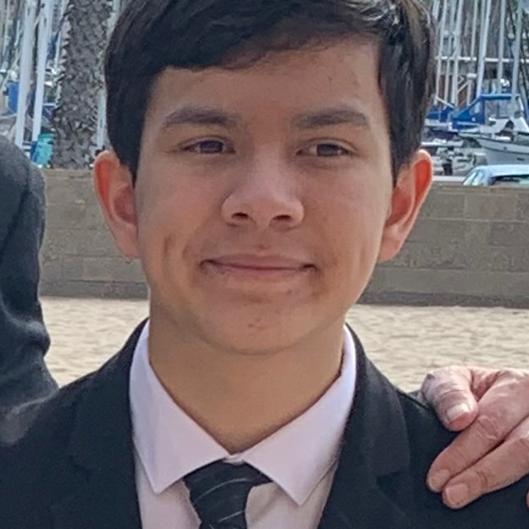
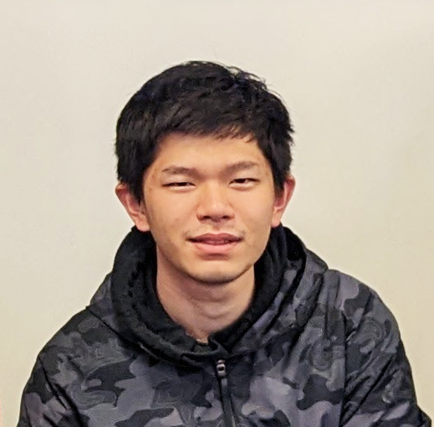

Course Staff
Mihir Dhamankar
Derek Duenas
Sirui (Ray) Huang
Justin Yoo

Slide 3
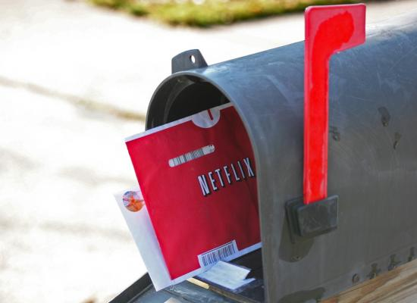
Failed Attempts at Security: Netflix Prize
$1million competition to improve Netflix’s recommendation system
100 million ratings from 500,000 users
“All customer identifying information has been removed; all that remains are ratings and dates … only a small sample was included, and that data was subject to perturbation”

Slide 4
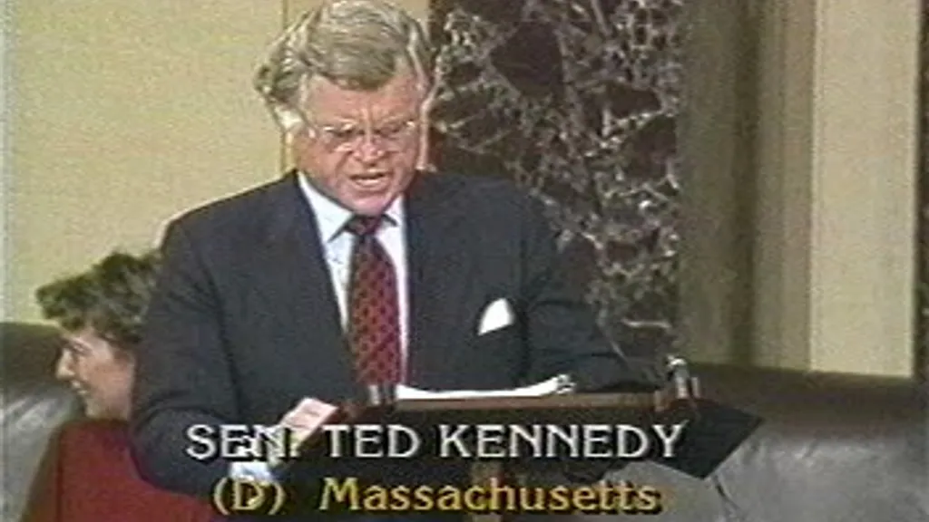
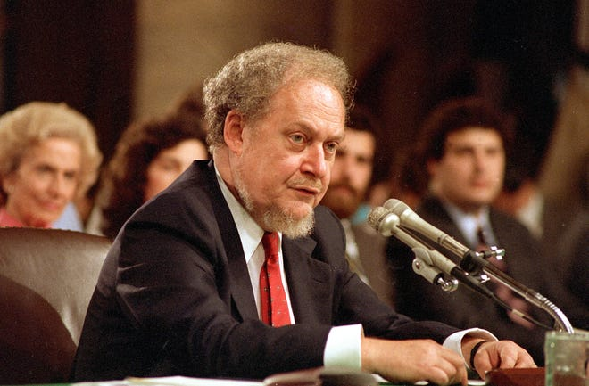
A brief digression
October 1987: US Senate rejects Robert Bork’s SCOTUS nomination 42-58
Ted Kennedy, 45 minutes after Bork’s nomination:
“Robert Bork's America is a land in which women would be forced into back-alley abortions, blacks would sit at segregated lunch counters, rogue police could break down citizens' doors in midnight raids, and schoolchildren could not be taught about evolution…”
During the debate, Bork’s video rental history was leaked to the press
Image source: Associated Press, 1987

Slide 5


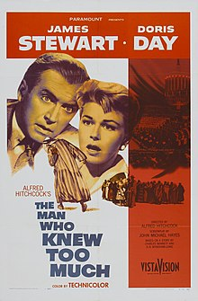

Damning revelations

Slide 6
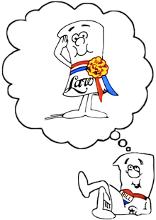
Video Privacy Protection Act of 1988
18 U.S. Code § 2710 –
Wrongful disclosure of video tape rental or sale records
(b)(1) A video tape service provider who knowingly discloses, to any person, personally identifiable information concerning any consumer of such provider shall be liable to the aggrieved person for the relief provided in subsection (c).
(c)(2) The court may award—actual damages but not less than liquidated damages in an amount of $2,500; punitive damages; reasonable attorneys’ fees; and such other preliminary and equitable relief as the court deems appropriate.

Slide 7
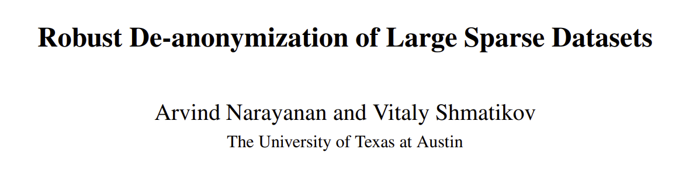
Recall: “All customer identifying information has been removed; all that remains are ratings and dates … only a small sample was included, and that data was subject to perturbation”
 | The Godfather | 12 Angry Men | Forrest Gump | … | Les Chiens | Bye Bye Monkey | Themroc | Sumo Do, Sumo Don’t | Spies
User1 | 5 | 4 | 3 | … |  |  |  | 5
User2 | 2 | 4 | 5 | … | 1
User3 | 5 | 5 | 5 | … |  |  |  |  | 3
Commonly Rated
More Obscure

Slide 8
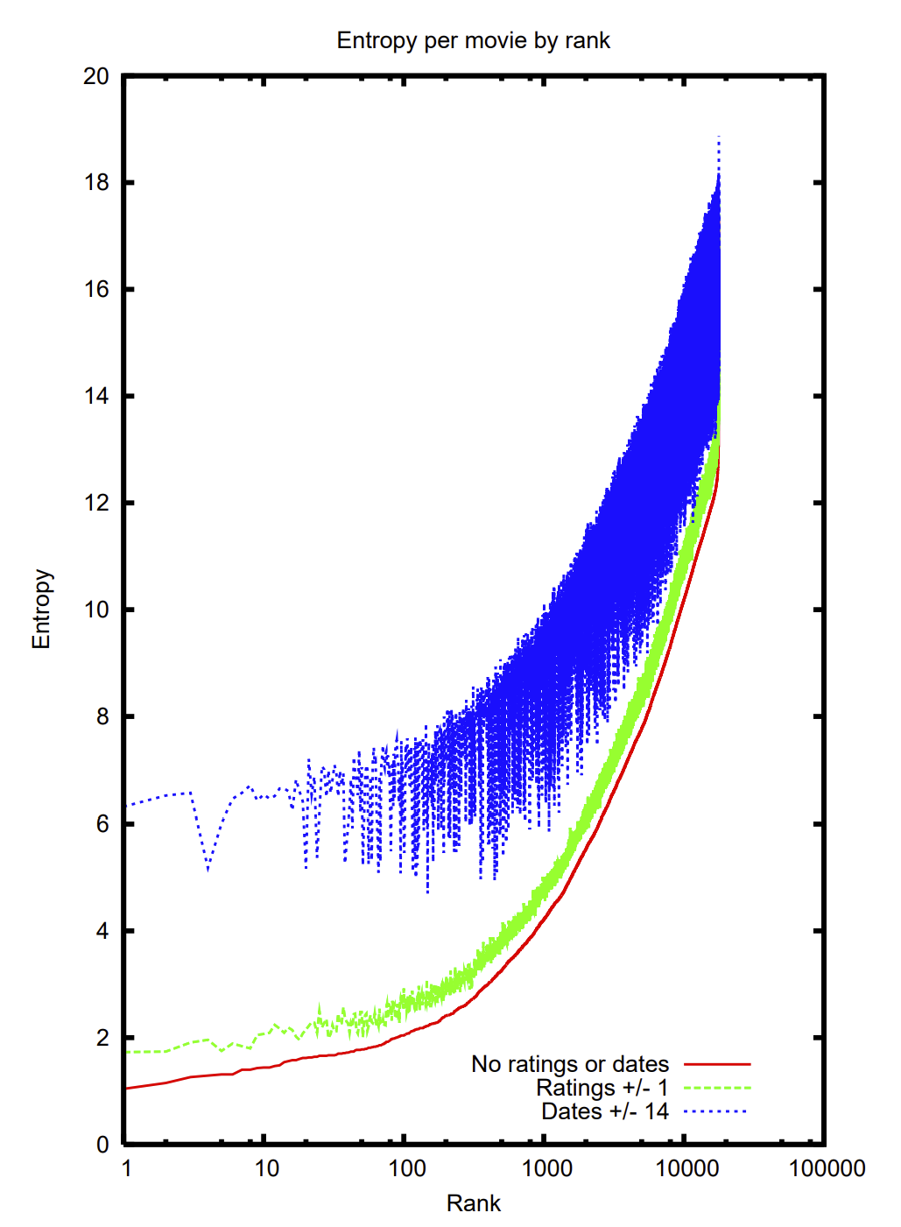
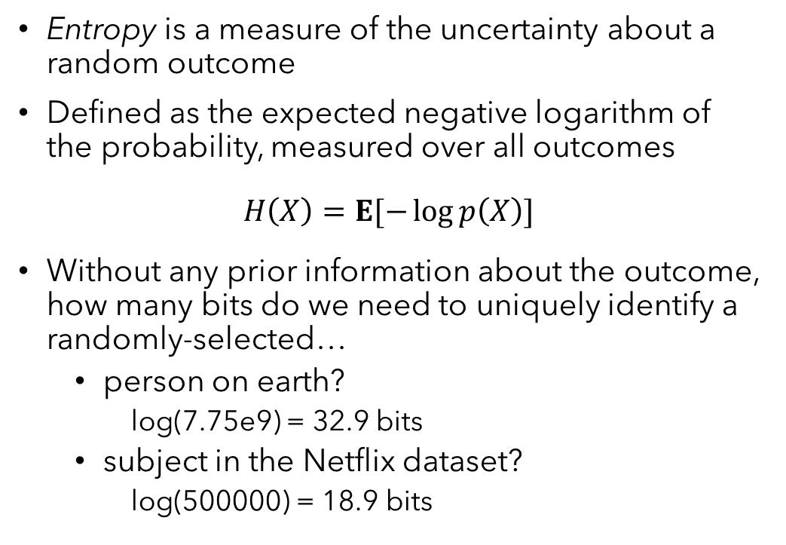
Entropy and identity
Entropy is a measure of the uncertainty about a random outcome
Defined as the expected negative logarithm of the probability, measured over all outcomes
$$H\left(X\right)=E[−\log{p\left(X\right)}]$$
Without any prior information about the outcome, how many bits do we need to uniquely identify a randomly-selected…
person on earth?
log(7.75e9) = 32.9 bits
subject in the Netflix dataset?
log(500000) = 18.9 bits

Slide 9
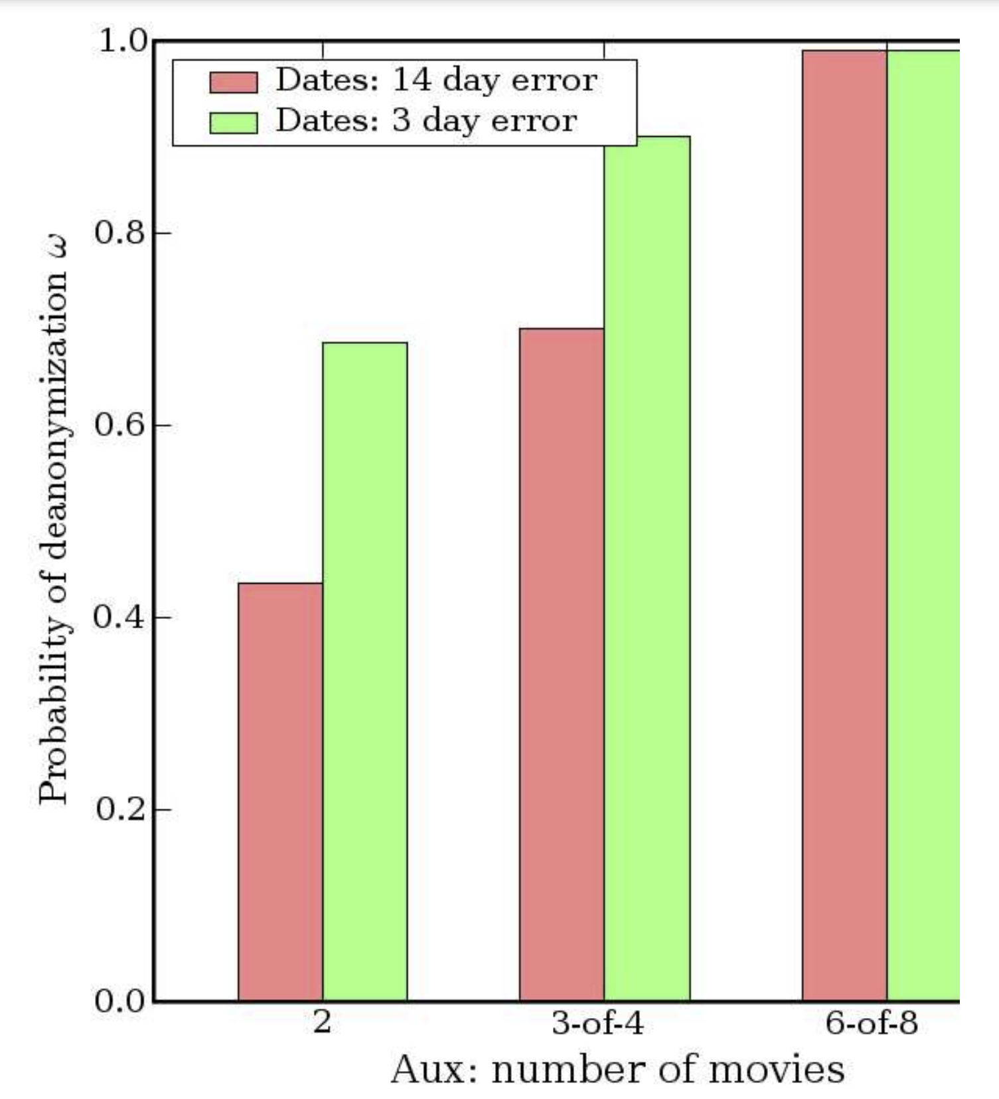
What is private information anyway?
Both Netflix and the law refer to personal identifying/identifiable information
Conventionally: name, unique identifiers, address, …
Results of this attack: “With 8 movie ratings (of which 2 may be completely wrong) and dates that may have a 14-day error, 99% of records be uniquely identified in the dataset. For 68%, two ratings and dates (with a 3-day error) are sufficient”
Netflix ended up settling a class-action lawsuit based on the Video Privacy Protection Act

Slide 10
Takeaways
Seemingly straightforward policy, surprisingly difficult to defend
Need to be methodical and unambiguous about:
Defining security goals
Identifying a policy that is sufficient to achieve them
Developing a comprehensive method of enforcing the policy
Demonstrating that the result matches the policy
Sneak peek: Differential Privacy
Goal: Person’s risk of privacy breach should not increase significantly due to their participation
Policy: Regardless of whether any single person is in the data, the output should remain about the same
Enforcement: Introduce carefully-designed randomness at key points in the computation
Result: Provable guarantee limiting what personal data can be learned via output

Slide 11
This course
Security from a programmer’s standpoint
We’ll cover a range of concerns
Safety: The code will never do something we deem “bad”
Isolation: Untrusted code and data can’t affect important state
Information Flow: Confidential data remains that way
Privacy: Control over peoples’ data and how it’s used
Authorization: Only designated actors/code can obtain rights
Trust: Leverage a small base to establish trust in a complete system
Recurring themes
Ways of specifying computations that are secure, i.e. policy
Ways of ensuring that code meets policy, i.e. enforcement
Formal ways of connecting the two, i.e. semantics

Slide 12
Logic and languages
Why is this a logic and languages elective?
Precise ways to write down policies
Types, logical formulas, domain-specific languages
Often devised for correctness, perfect for security also
Enforcing them rigorously
Static: verification, type checking
Dynamic: runtime monitors, code instrumentation
Either way, prove that the policy won’t be violated

Slide 13
Learning objectives
After taking this course, you should:
Be able to identify, formalize, and implement a range of practical security & privacy policies
Understand the tradeoffs of different approaches to security & privacy, and how to use context-specific rationale to justify them
Understand how general principles like least privelege, roots of trust, and complete mediation play a role in formulating and vetting defenses
Be able to provide a formal, rigorous argument for several types of security mechanisms that are used in practice

Slide 14
Logistics
Website: https://cs.cmu.edu/~15316
Contact: Piazza
Lecture: This room, same time, Tuesday/Thursday
Attendance expected, but not recorded
Piazza is not a substitute for attending lecture
Submit everything to Gradescope
Office hours
My office, Fridays from 1:00-2:30
TAs in Gates Commons or CIC, details posted soon

Slide 15
Grading
Breakdown:
35% written homework
35% labs
15% final exam
15% quizzes
Final letter grades
90/80/70/60 thresholds
Round up
Six written homeworks
2 labs
7 quizzes
Final exam during finals week
Late assignments lose 10% per day, max 4 days
Lowest homework, quiz dropped

Slide 16
Written homework (35%)
Focus on theory + fundamental skills
1 week to complete
Due dates for the semester are on the course website
Grades based on:
Correctness (obviously)
Rigor
Clarity
Rigor and clarity in this course:
Formally state what you intend to show
List any assumptions
Show your steps, with appropriate justification

Slide 17
Labs (35%)
Translate theory into something that works
Design a set of policies and a way of enforcing them
Formalize both
Implement them for the setting described in the lab
Learn to use new tools in the process
Grades are based on:
Correct functionality (evaluated by autograder)
Completeness, robustness of security mechanism
Documentation, clarity of your solution
Complete the labs independently!
We can help with: understanding the setting/concepts, critiquing your approach, explaining strengths/limitations of tools
We’re less useful for: debugging code, leaking autograder tests, giving last-minute hints

Slide 18
Quizzes (15%)
Seven quizzes spread (roughly) evenly over semester:
Quiz handed out at start of lecture, due 2pm on Wednesday
Released on Canvas after lecture
Ask questions during lecture!
After class, you may only use lecture notes
Why?
Attendance is expected
Things come up, we understand
This mechanism encourages you to stay current with material

Slide 19
Final Exam (15%)
Reason & apply main ideas from this course
In-person, cumulative
Questions resemble less time-intensive homework problems
Representative practice exam released the last week of classes
Not a check on your recall of minute details
Exam comes with an extensive formula sheet
You may bring 1 page of handwritten notes

Slide 20
Before Thursday
Make sure that you are enrolled in Gradescope, Canvas, Piazza sections
Piazza signup: https://piazza.com/class/llttvbb8vxs3kf
Gradescope code: KK5PZ7
Canvas link: https://canvas.cmu.edu/courses/37184
Answer Piazza poll about OH times
Read the syllabus, reach out if there are questions

